Slide 1

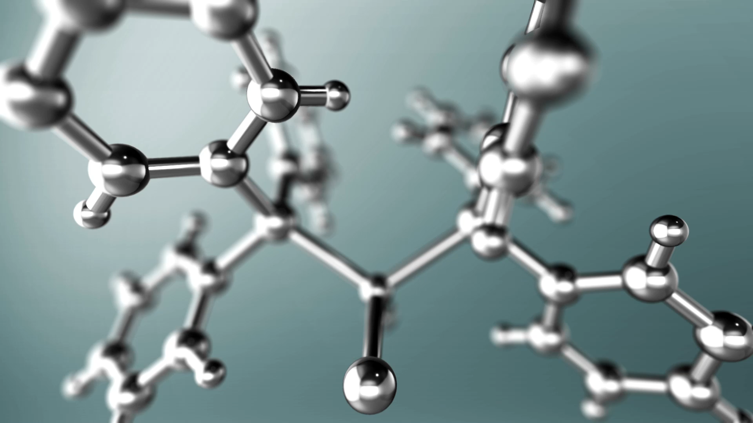
PREDICTION

Slide 2
NAME : N . Lakshmi Sri
Hall ticket NO.: 2203A52230
Section: CSE-AA
Trainer:
D . Ramesh
Asst. professor
CSE(AI&ML)

Slide 3
Problem Statement : "Develop a predictive model using a breast cancer dataset to accurately classify tumors as benign or malignant, enabling early detection and intervention for potential breast cancer cases."

Slide 4
"Early detection is your best protection."

Slide 5
INTRODUCTION
Breast cancer is a disease that affects millions of people each year, both men and women. It is a serious illness that can have devastating consequences if not detected and treated early. That's why it's so important to learn about breast cancer and understand the basics of this disease.
Breast cancer can be a scary topic, but it's important to approach it with compassion and understanding. By learning about breast cancer, you can help yourself and others stay informed and take steps to reduce your risk of developing this disease.

Slide 6

What is Breast Cancer?
Breast cancer is a type of cancer that starts in the cells of the breast. These cells can grow uncontrollably and form a mass or lump. Breast cancer can occur in both men and women, but it is much more common in women.
The exact cause of breast cancer is not known, but there are certain risk factors that can increase a person's chances of developing it. Some of these risk factors include age, family history, and exposure to estrogen. Breast cancer can also develop in people with no known risk factors.

Slide 7
Causes of Breast Cancer
Risk Factors
While the exact cause of breast cancer is unknown, there are certain risk factors that increase the likelihood of developing the disease. These include:
Gender: Women are more likely to develop breast cancer than men.
Age: The risk of breast cancer increases as a person gets older.
Family history of breast cancer: Having a close relative with breast cancer increases the risk of developing the disease.
Certain gene mutations: Inherited mutations in the BRCA1 and BRCA2 genes increase the risk of breast cancer.
Impact on Men
While breast cancer is more common in women, men can also develop the disease. In fact, about 1 in every 100 cases of breast cancer occurs in men. Men with breast cancer may experience similar symptoms to women, such as a lump in the breast or nipple discharge.
Impact on Women
Breast cancer is the most common cancer among women worldwide. It can have a significant impact on a woman's physical and emotional well-being, as well as her relationships and daily life. Early detection through regular mammograms and self-exams can improve the chances of successful treatment and recovery.

Slide 8
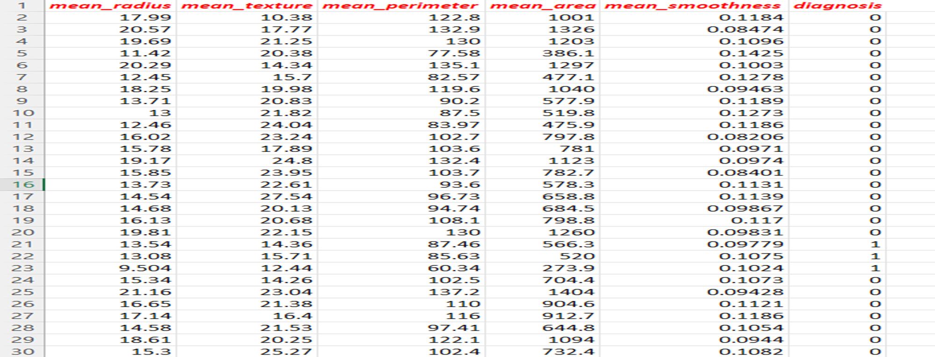
CANCER PREDICtion dataset
570-Instances and 6 Attributes

Slide 9
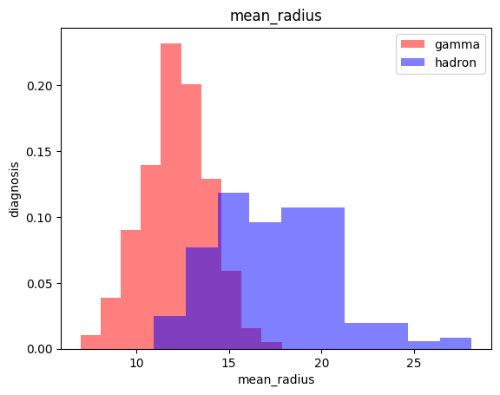
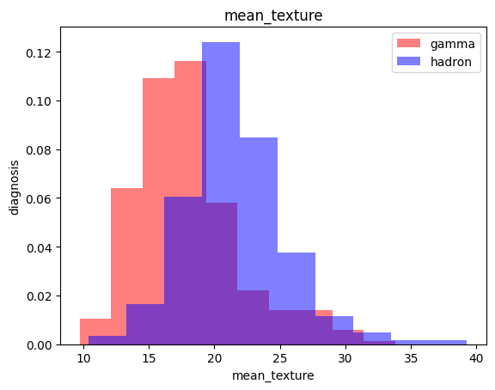
GRAPHS(Features Vs Target)

Slide 10
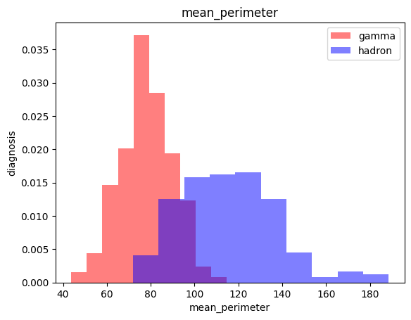
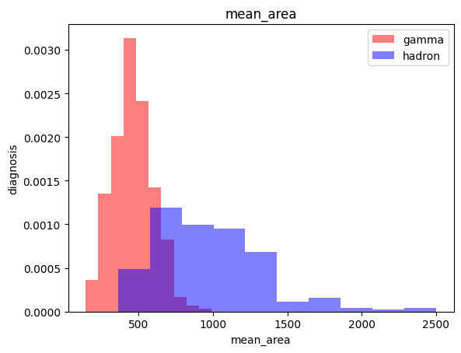

Slide 11
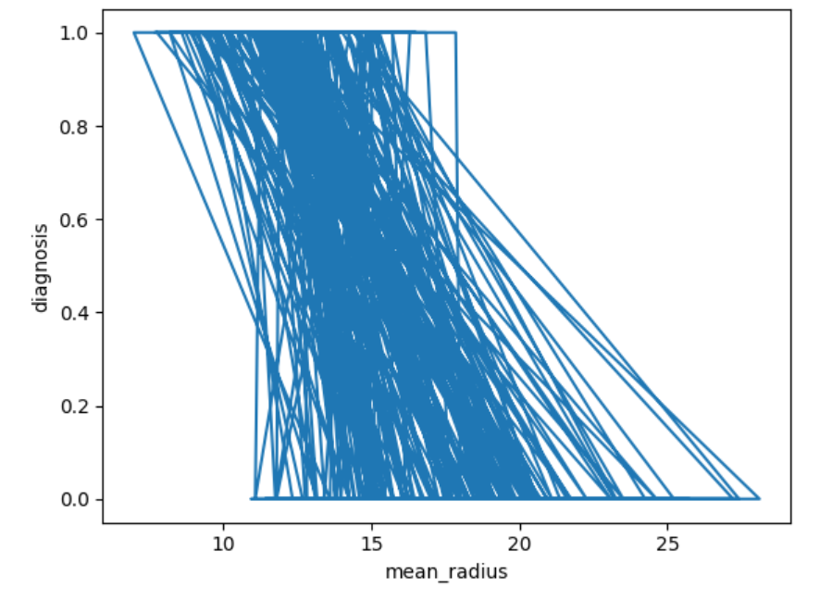
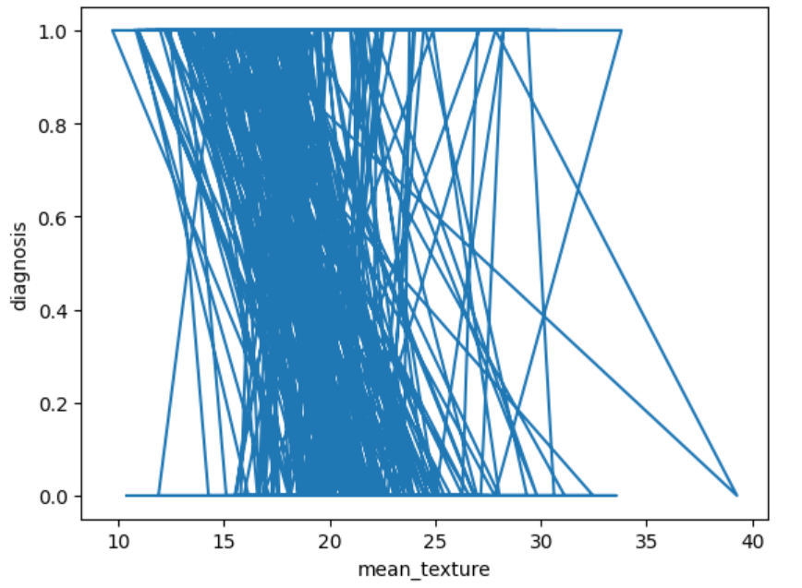

Slide 12
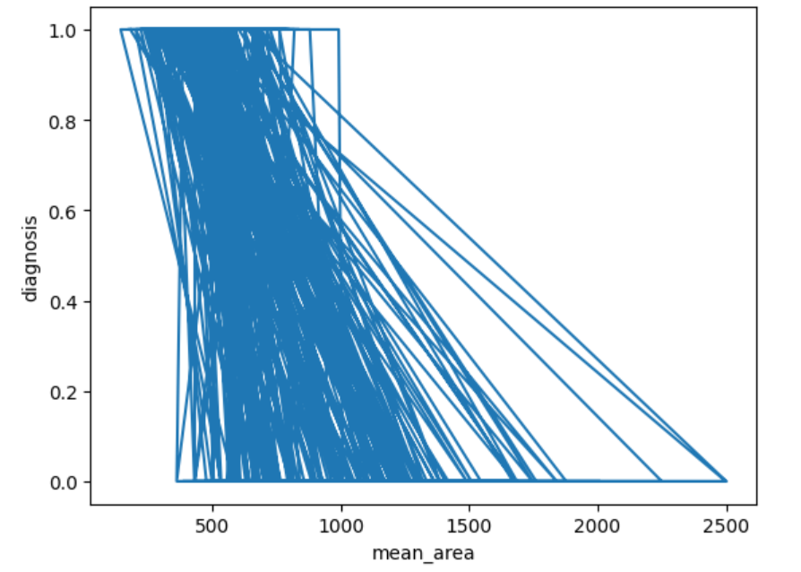
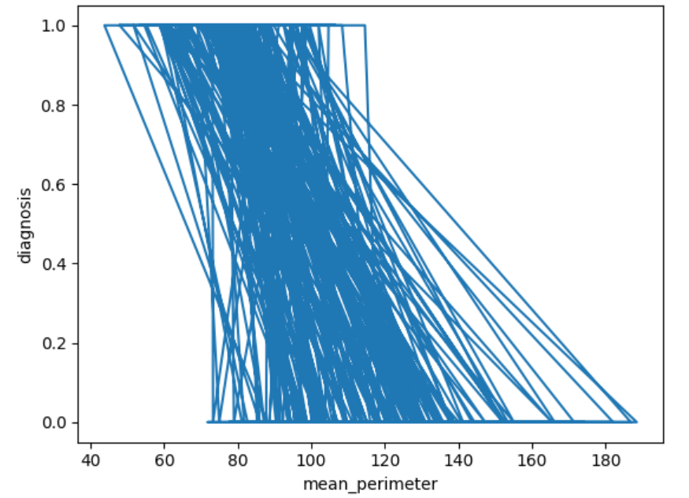
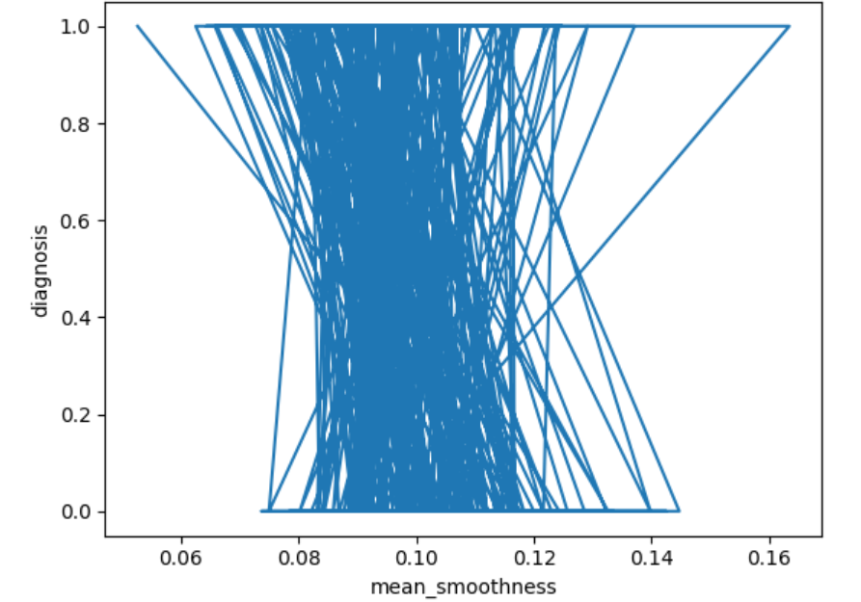

Slide 13
Introduction to Machine Learning Models
Welcome to the world of machine learning models! In this presentation, we'll be exploring what machine learning models are and why they're so important. At their core, machine learning models are algorithms that can learn from data and make predictions or decisions based on that learning. They're used in a wide range of applications, from self-driving cars to personalized medicine.
But why are machine learning models so important? For one, they allow us to automate tasks that would be impossible or impractical for humans to do manually. They also enable us to make better decisions by providing insights and predictions based on large amounts of data. And as more and more data becomes available, machine learning models will only become more powerful and useful.

Slide 14

The machine learning models used for this project are
SVM
PERCEPTRON LEARNING
LOGISTIC REGRESSION
KNN
BOOTSTRAP

Slide 15
Support Vector Machine (SVM) Model
Overview
SVM is a popular machine learning algorithm used for classification and regression analysis. It is a supervised learning technique that can be used for both linear and non-linear data. SVM works by finding a hyperplane that best separates the data into different classes, with the largest margin between the hyperplane and the closest data points. SVM is known for its ability to handle high-dimensional data and its robustness to overfitting.
Applications
Image classification: SVM can be used to classify images based on their features, such as color, texture, and shape.
Text classification: SVM can be used to classify text documents based on their content, such as sentiment analysis or spam detection.
Bioinformatics: SVM can be used to analyze biological data, such as gene expression data or protein structure prediction

Slide 16
SVM IN HEALTH CARE
Healthcare
SVMs can be used in healthcare for disease diagnosis, drug discovery, and patient monitoring. For example, SVMs can be trained to classify medical images, such as X-rays and MRIs, to identify abnormalities and assist in diagnosis.

Slide 17
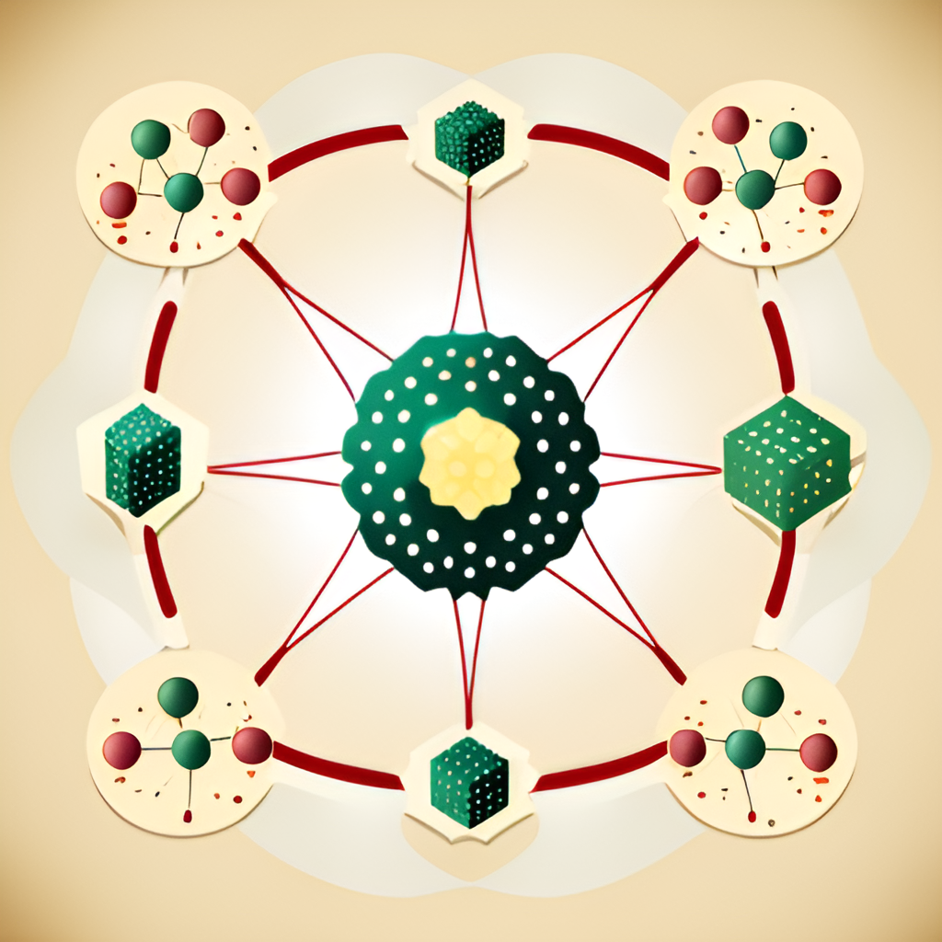
Perceptron Learning
What is Perceptron Learning?
Perceptron learning is a type of supervised learning algorithm used in machine learning models. It is a binary classifier that separates input data into two classes using a linear decision boundary. The perceptron learning algorithm adjusts the weights of the input features to minimize the error between the predicted output and the actual output.
Application in Machine Learning Models
Perceptron learning can be used in various machine learning models, including neural networks and support vector machines (SVMs). In neural networks, perceptrons are used as building blocks to create more complex models. In SVMs, perceptron learning is used to find the optimal hyperplane that separates the input data into different classes.

Slide 18
Logistic Regression
Overview
Logistic regression is a statistical method used to analyze and model the relationship between a binary dependent variable and one or more independent variables. It is often used in machine learning models to predict the probability of an event occurring based on given inputs.
How it Works
Logistic regression works by fitting a logistic function to a set of training data, where the output is a probability score between 0 and 1. The logistic function is a sigmoid curve that maps any input value to a value between 0 and 1. The output of the logistic function can be interpreted as the probability of the dependent variable being true given the input values.
The logistic regression equation is represented as: p = 1 / (1 + e^(-z)), where p is the predicted probability, e is the base of the natural logarithm, and z is a linear combination of the input variables.

Slide 19
SVM Algorithm
The SVM algorithm is a powerful tool in machine learning that is used for classification tasks. At its core, the algorithm works by finding the hyperplane that best separates two classes of data points. This hyperplane is chosen to maximize the margin between the two classes, which helps to improve the algorithm's ability to generalize to new data. In addition to finding the hyperplane, the SVM algorithm also uses kernel functions to transform the input data into a higher-dimensional space where it is easier to separate the classes.
One of the key components of the SVM algorithm is the choice of kernel function. There are many different types of kernel functions available, each with its own strengths and weaknesses. Some common kernel functions include linear, polynomial, and radial basis function (RBF) kernels. The choice of kernel function can have a significant impact on the performance of the algorithm, so it is important to choose the right one for the task at hand.

Slide 20

.
Here are the key concepts and components of SVM:
Support Vectors: In SVM, support vectors are the data points that are closest to the decision boundary (hyperplane) and have a direct influence on its position. These points are critical in determining the margin and the overall performance of the classifier.
Hyperplane: SVM's primary objective is to find the optimal hyperplane that best separates the data into two classes. For a two-dimensional feature space, this hyperplane is simply a line. In higher-dimensional spaces, it becomes a hyperplane.
Margin: The margin is the distance between the hyperplane and the nearest support vectors. SVM aims to maximize this margin because a larger margin generally implies better generalization to unseen data and reduced overfitting.
Kernel Trick: SVMs can handle non-linear data by transforming the original feature space into a higher-dimensional space using a kernel function. This transformation allows SVM to find a linear hyperplane in the new space, effectively capturing non-linear relationships in the original data.
C Parameter: The C parameter (also known as regularization parameter) controls the trade-off between maximizing the margin and minimizing classification errors. Smaller values of C result in a larger margin but may allow some misclassification, while larger values of C aim to classify all training data correctly but might lead to a smaller margin.

Slide 21
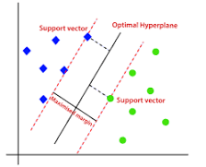
Here's a simplified example of how SVM works:
Given a dataset with two classes, SVM tries to find the hyperplane that best separates the data points of these classes.
It identifies the support vectors, which are the closest data points to the hyperplane.
By maximizing the margin, SVM finds the optimal hyperplane position.
For non-linear data, a kernel function can be used to transform the data into a higher-dimensional space, where a linear hyperplane can be found.
When new data points need to be classified, they are placed in the feature space and classified based on which side of the hyperplane they fall.

Slide 22
Perceptron learning algorithm
The Perceptron learning algorithm is one of the simplest supervised learning algorithms used for binary classification tasks. It's a type of artificial neural network and was developed by Frank Rosenblatt in the late 1950s. The Perceptron is a building block for more complex neural networks and served as an early inspiration for the development of modern neural network architectures.

Slide 23
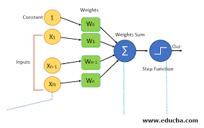
Perceptron Model: The Perceptron is a single-layer neural network with a simple architecture. It takes a set of input features (x) and assigns weights (w) to each feature. It calculates the weighted sum of inputs and applies an activation function (typically a step function) to produce an output, which is either 0 or 1 (binary classification).
Initialization: Initially, the weights are assigned random values or set to zero.
Training Data: The Perceptron is trained using labeled training data, where each data point is associated with a known class label (either 0 or 1).
Training Algorithm:
For each training example (x), the Perceptron computes the weighted sum of inputs:
weighted_sum = w1 * x1 + w2 * x2 + ... + wn * xn
The output (y) is then determined using an activation function (step function):if weighted_sum >= 0: y = 1else: y = 0

Slide 24
Logistic regression algorithm
Logistic regression is a widely used statistical and machine learning algorithm for binary classification problems, where the goal is to predict one of two possible outcomes (typically 0 or 1). Despite its name, logistic regression is used for classification rather than regression tasks. It's a type of generalized linear model (GLM) that models the probability that a given input belongs to a particular class.

Slide 25
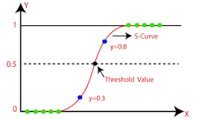
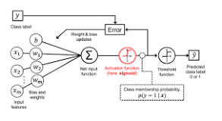
Sigmoid Function (Logistic Function): Logistic regression uses the sigmoid function to model the relationship between the input features and the probability of the positive class (class 1). The sigmoid function, denoted as σ(z), maps any realσ(z) = 1 / (1 + e^(-z))-valued number 'z' to a value between 0 and 1:
Linear Combination of Features: The logistic regression model assumes a linear relationship between the input features and the log-odds (logit) of the positive class. The linear combination of input features is represented as:
z = w0 + w1*x1 + w2*x2 + ... + wn*xn
'z' is the log-odds of the positive class.
'w0', 'w1', 'w2', ..., 'wn' are the coefficients (weights) associated with each feature.
'x1', 'x2', ..., 'xn' are the input features.

Slide 26
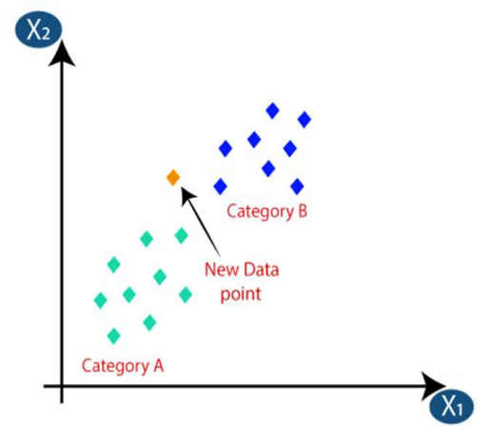
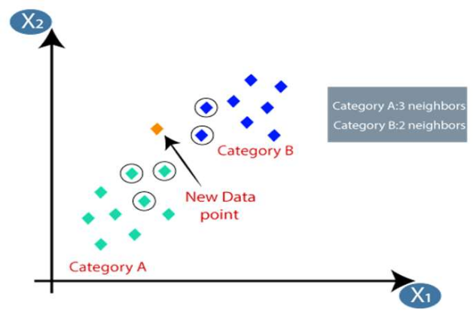
K-NEAREST NEIGHBOUR
I used the KNN classifier from scikit-learn, where the model learns by memorizing the entire training dataset. During prediction, it identifies the k-nearest neighbors of a given data point and assigns the majority class among them to the point. KNN is a non-parametric, lazy learning algorithm used for both classification and regression tasks.
The K-NN working can be explained on the basis of the below algorithm:
Step-1: Select the number K of the neighbors
Step-2: Calculate the Euclidean distance of K number of neighbors
Step-3: Take the K nearest neighbors as per the calculated Euclidean distance.
Step-4: Among these k neighbors, count the number of the data points in each category.
Step-5: Assign the new data points to that category for which the number of the neighbor is maximum.
Step-6: Our model is ready.
Suppose we have a new data point and we need to put it in the required category

Slide 27
BOOTSTRAP
"bootstrapping" refers to a resampling technique used to estimate the sampling distribution of a statistic by repeatedly resampling with replacement from the observed data. It is particularly useful when the available dataset is limited and obtaining additional data is difficult or costly
Bootstrapping is widely used in machine learning for tasks such as model evaluation, feature selection, and ensemble methods
Bootstrapping in machine learning is a resampling technique where multiple random samples are created by drawing data points from the original dataset with replacement. These samples are used to train multiple models, and the results are aggregated to improve accuracy and estimate uncertainties. Bootstrapping is valuable for making predictions, evaluating models, and understanding the variability and reliability of machine learning algorithms, especially when data is limited.

Slide 28
bootstrapping works in machine learning
Sample with Replacement: Bootstrapping involves creating multiple random samples (called bootstrap samples) from the original dataset by randomly selecting data points with replacement. This means that some data points may be selected multiple times in the same sample, while others may not be selected at all.
Building Models: Each bootstrap sample can be used to train a machine learning model independently. For instance, you can train a regression model or a classification algorithm on each of these samples.
Aggregating Results: After building models on each bootstrap sample, the results (such as model parameters, predictions, or evaluation metrics) are collected and aggregated to obtain a final result. For example, in regression problems, you might average the predictions from all bootstrap models to get a more stable and accurate prediction. In classification problems, you might use techniques like bagging (Bootstrap Aggregating) where the majority vote or averaging of probabilities from different models is considered.
Estimating Uncertainty: One of the key advantages of bootstrapping is its ability to estimate the uncertainty associated with a statistic or model parameter. By creating multiple bootstrap samples and observing the variability in the results, you can calculate confidence intervals, standard errors, and other measures of uncertainty. This is valuable for understanding the stability and reliability of your machine learning models.

Slide 29
BOOTSTRAP WITH CALUCLATION
To create a bootstrap sample of size nn, where nn is the size of the original dataset:
Randomly select nn data points from the original dataset with replacement.
Calculate Sample Statistics: After obtaining each bootstrap sample, you can calculate various statistics or parameters of interest. For example, if you want to calculate the mean of a sample:
Mean of the bootstrap sample: xˉ∗=1n∑i=1nxixˉ∗=n1​∑i=1n​xi​ (where xixi​ represents each data point in the bootstrap sample)
Aggregate Results: After obtaining statistics from multiple bootstrap samples, you can aggregate the results to estimate population parameters or assess model performance. For example, if you want to calculate the average of a statistic across all bootstrap samples:
Average of the statistic: θˉ=1B∑j=1Bθjθˉ=B1​∑j=1B​θj​ (where θjθj​ represents the statistic calculated from the jjth bootstrap sample, and BB is the total number of bootstrap samples)

Slide 30
Bootstrap and SVM (Support Vector Machine)
Bootstrap and SVM (Support Vector Machine) Application:
SVM is a supervised learning algorithm used for classification and regression tasks. Bootstrapping can be used to assess the stability of the SVM model and improve its generalization performance.
By generating multiple bootstrap samples from the training data, you can train multiple SVM models. After training, these models can be aggregated (e.g., through voting in classification tasks) to create an ensemble model. This ensemble approach helps in making more robust predictions and handling outliers effectively.

Slide 31
Bootstrap and Logistic Regression
Bootstrap and Logistic Regression
Application:
Logistic Regression is a popular classification algorithm used for binary and multi-class classification problems. Bootstrapping can be applied to evaluate the performance of the logistic regression model and estimate confidence intervals for model parameters.
Bootstrapping can be used to create multiple training datasets. Logistic regression models are trained on these datasets, and the model parameters (coefficients) can be averaged or analyzed for variance across bootstrap samples. This helps in understanding the stability of the model and the uncertainty associated with the coefficients.

Slide 32
Bootstrap and Perceptron Learning
Bootstrap and Perceptron Learning
Application:
Perceptron is a linear binary classification algorithm used for supervised learning. Bootstrapping can be used to create diverse training sets for the perceptron algorithm, improving its robustness and accuracy.
By generating multiple bootstrap samples, different perceptron models can be trained. These models can be combined through voting or averaging techniques to create an ensemble perceptron. This ensemble approach helps in reducing overfitting and improving the overall classification performance of the perceptron algorithm.

Slide 33
Bootstrap and k-Nearest Neighbors (kNN)
Bootstrap and k-Nearest Neighbors (kNN)
Application:
Bootstrapping can be employed to create multiple subsets of the training data. kNN models are trained on these subsets, and predictions are made on the test data. The predictions from different kNN models can be combined (e.g., averaging in regression tasks or voting in classification tasks) to create an ensemble prediction. This ensemble approach helps in reducing noise and improving the accuracy of kNN predictions.
kNN is a non-parametric, instance-based learning algorithm used for classification and regression tasks. Bootstrapping can be used to assess the stability of kNN predictions and improve the algorithm's generalization on unseen data.

Slide 34
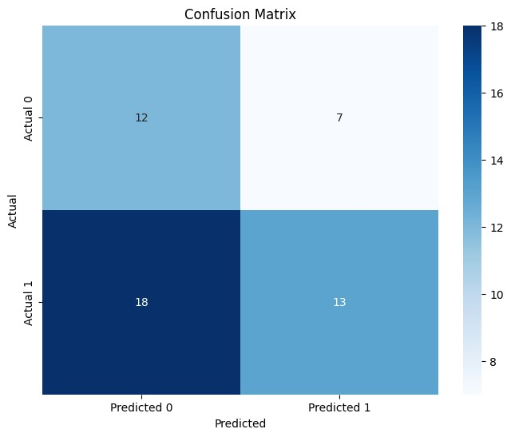
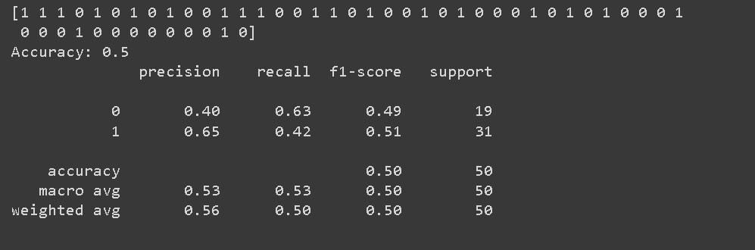
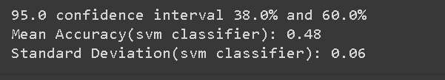
SVM:

Slide 35
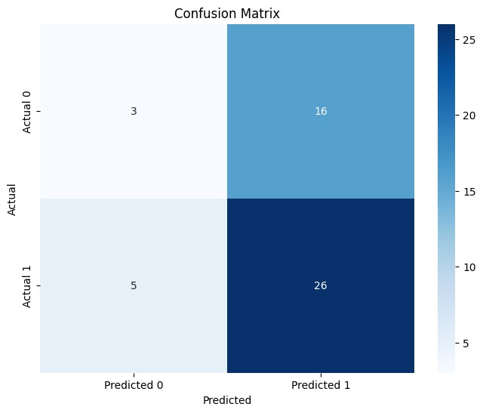
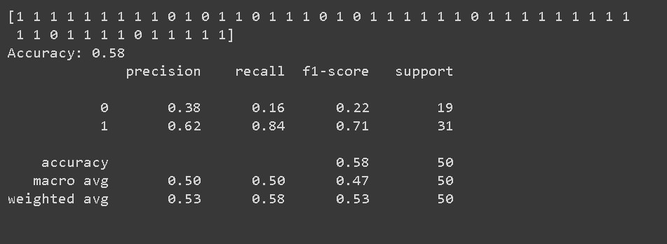
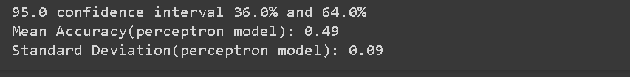
PERCEPTRON
LEARNING:

Slide 36
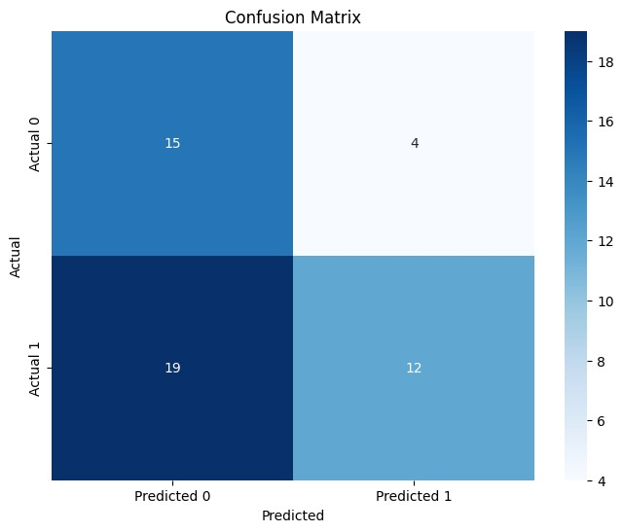
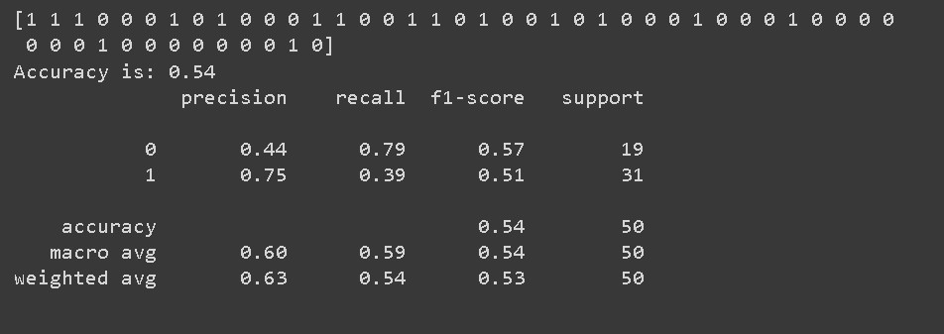
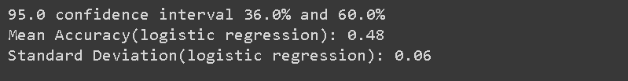
LOGISTIC REGRESSION:

Slide 37
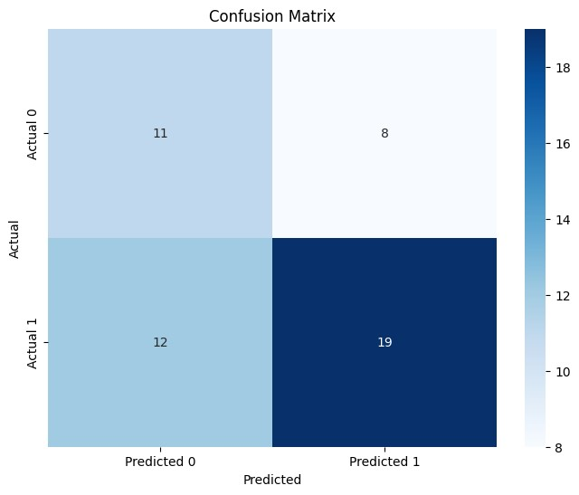
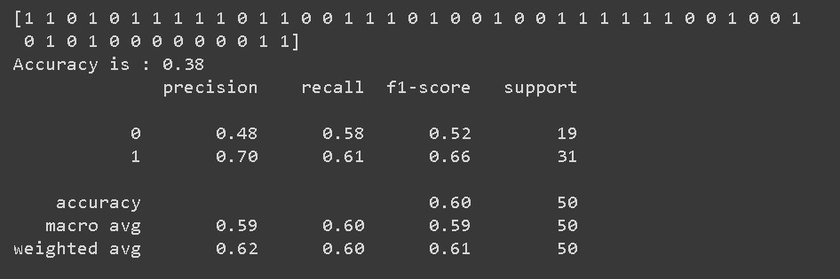
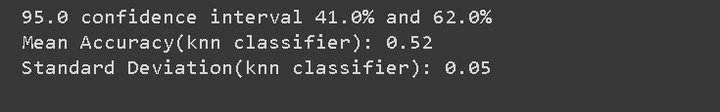
KNN:

Slide 38
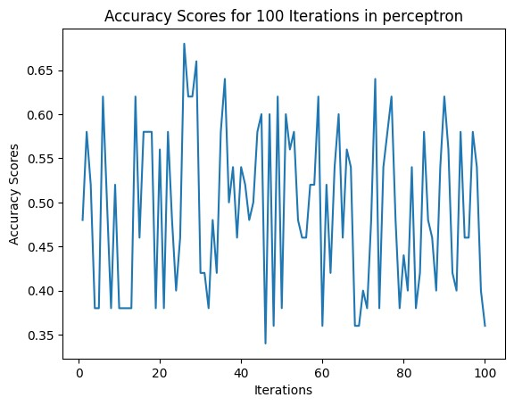
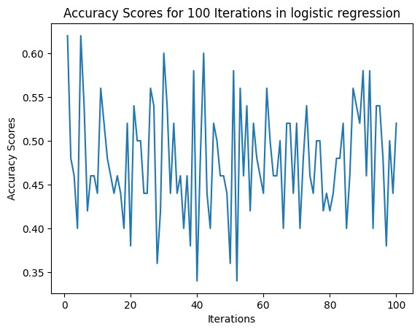
BOOTSTRAPPING:

Slide 39
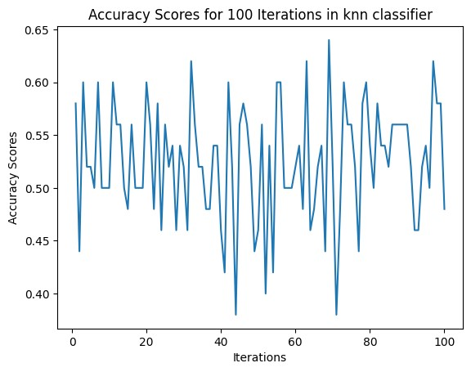
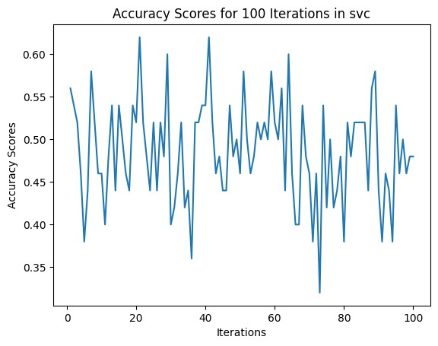

Slide 40
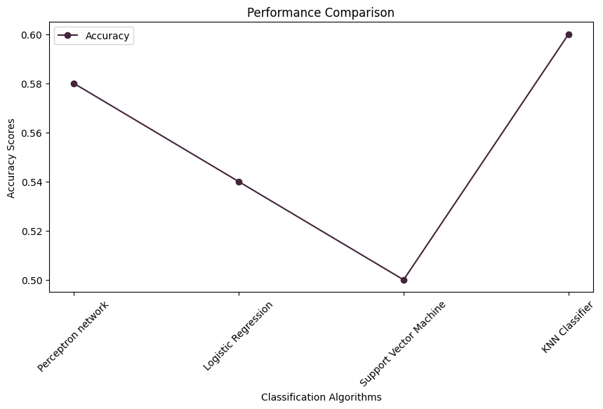
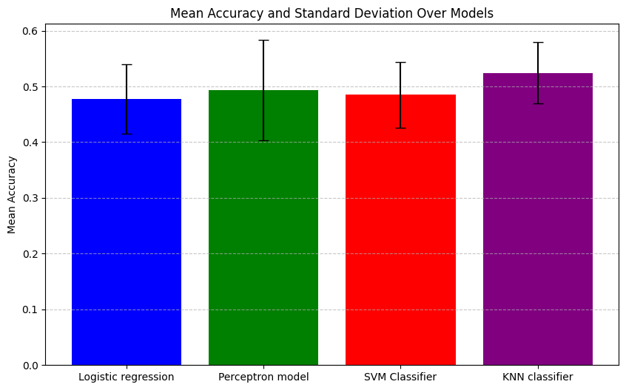
GRAPHS:

Slide 41
OUTPUT
The results indicate that the Perceptron model has the highest mean accuracy (0.49) but also the highest standard deviation (0.09), suggesting significant fluctuation in its performance. On the other hand, the K-Nearest Neighbors (KNN) classifier demonstrates slightly lower mean accuracy (0.52) but a much lower standard deviation (0.05), indicating more consistent results. Logistic Regression and SVM have similar mean accuracies (0.48) and moderate standard deviations (0.06), making them reasonably stable models. Therefore, the conclusion is that the Perceptron model is the most fluctuating, while the KNN classifier is the most consistent in its predictive performance.
The Perceptron model exhibits the most fluctuation because it relies on random weight and bias initialization in each iteration, leading to significant variability in its performance.
In contrast, K-Nearest Neighbors (KNN) classifier tends to be more consistent as it makes predictions based on the proximity of data points, and it does not rely on random initializations. KNN's performance remains relatively stable as the dataset and distance metric remain constant.

Slide 42
CONCLUSION
One of the crucial real-world medical challenges is the early detection of breast cancer. In this study, comprehensive efforts have been dedicated to designing a system aimed at predicting breast cancer. While the exact causes of breast cancer remain a subject of ongoing research, making prediction challenging, we have undertaken experiments using available datasets with the goal of creating a highly accurate predictive model.
The objective is to develop a system that can effectively predict the presence of breast cancer, similar to the way diabetes prediction systems are developed. Although the causes of breast cancer may not be fully understood, the focus is on leveraging data-driven approaches to create a robust predictive model.
Through this research, we aspire to contribute to the early detection and intervention of breast cancer, ultimately improving outcomes for individuals at risk.

Slide 43
GITHUB LINK:
https://github.com/lakshmisrinallani/Review-2

Slide 44
Thank you

